Slide 1
Dress Code
November 25, 2022
Human Resource Team

Slide 2
Table of Content
Overview
VFD Tech Ladies
VFD Tech Men
Violations and Disciplinary Consequences
Presentation Outline
5

Slide 3
Overview
Objectives - The dress code policy is intended to assist all employees in presenting a consistent professional appearance to our customers and coworkers. Our physical appearance reflects on both ourselves and the company. The goal is to maintain a positive image and avoid offending customers, clients, or colleagues.
Scope - The dress code policy is applicable to all employees who work with the company. While working in the office and while on company business trips, such as client meetings, conferences, training sessions, or business events, employees are expected to adhere to the dress code guideline.
Elements
Employees must always present a clean, professional appearance. Everyone is expected to be well-groomed and wear clean clothing, free of holes, tears, or other signs of wear to ensure professionalism and avoid being offensive to third-party within the ecosystem.
Client facing employees are required to dress in line with the policy of the organization being visited.
Clothing with offensive or inappropriate designs or stamps are not allowed.
The dress should be appropriate to the work environment. Too revealing clothes are not allowed.
Clothes offensive to other employees or public should be avoided.
Every employee is expected to ensure that personal hygiene is taken seriously and work against any form of body odor.
Armpit hair is required to be shaved for employees who intend on wearing sleeveless outfits.
All forms of slippers are strictly prohibited.

Slide 4
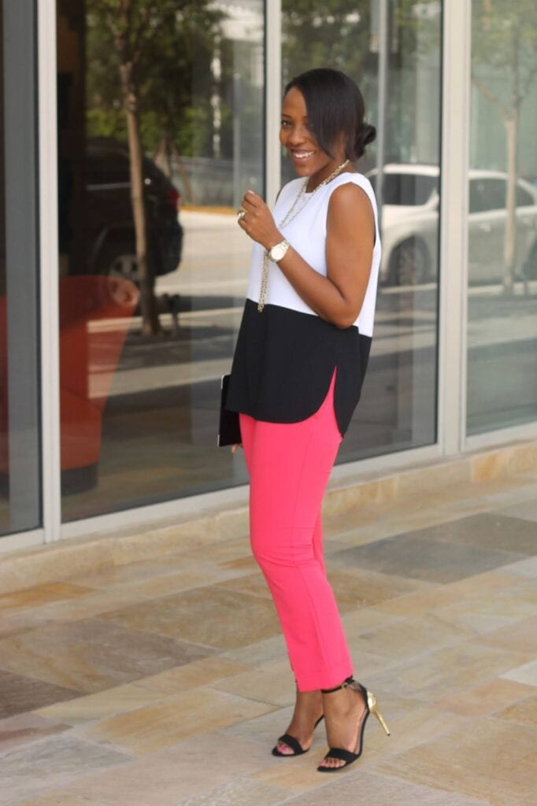
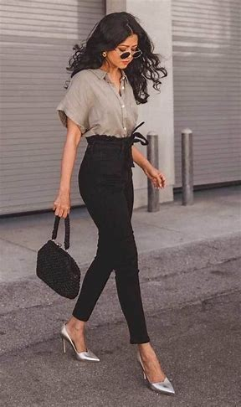
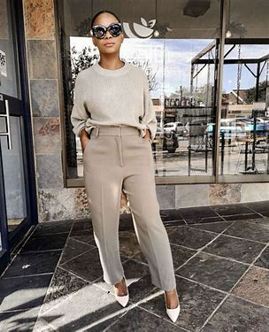
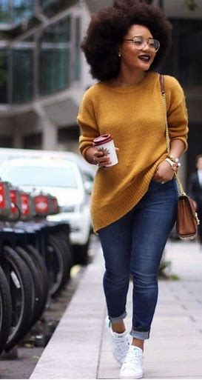
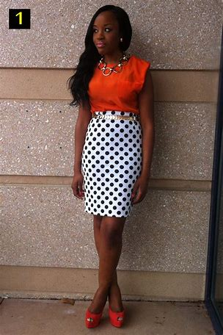
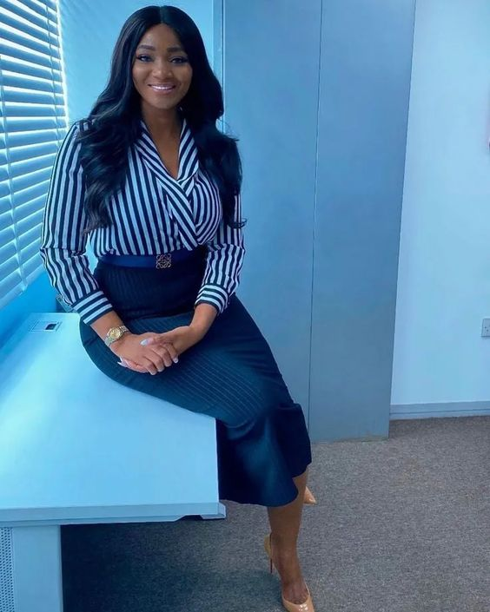
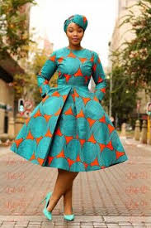
VFD Tech Ladies
Dress Code – Corporate casual, Traditional attires or casual all week
Be comfortable, decent and chic… Monday- Friday

Slide 5
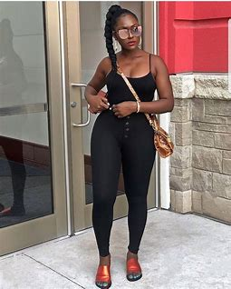
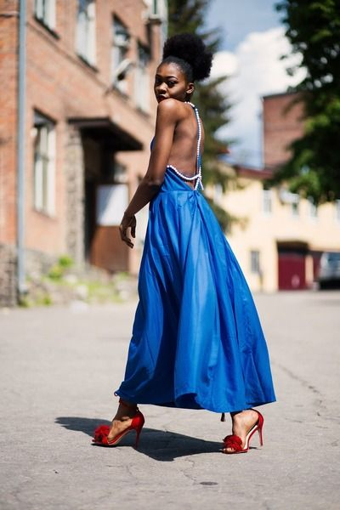
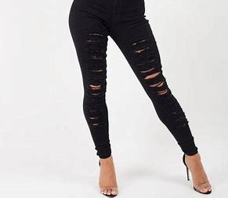
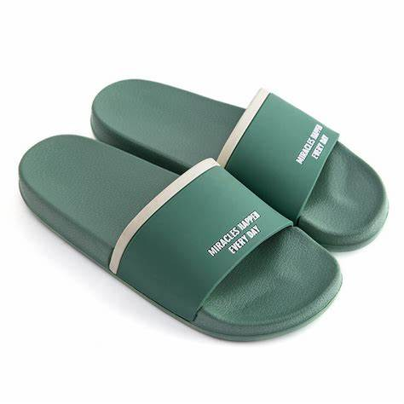
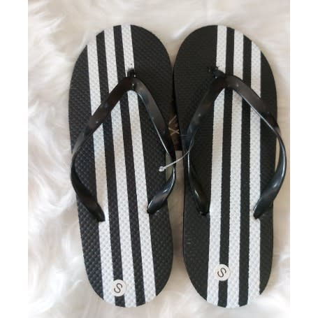
VFD Tech Ladies… don’ts

Slide 6
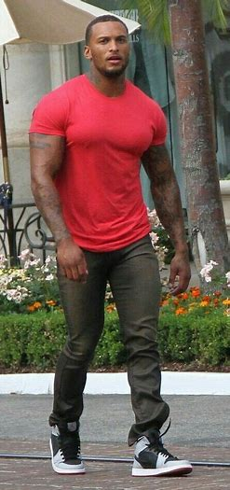
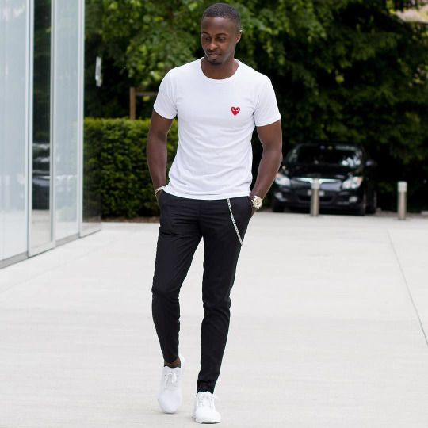
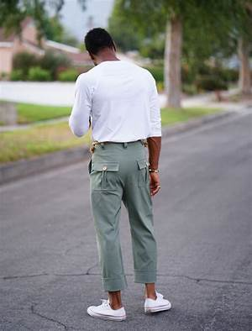
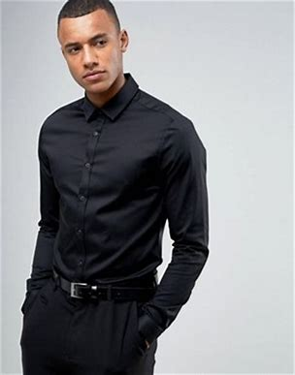
VFD Tech Men
Dress Code – Corporate casual, Traditional attires or casual all week

Slide 7
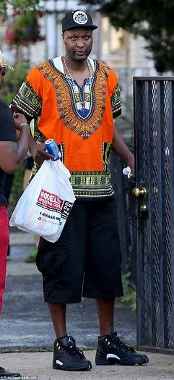
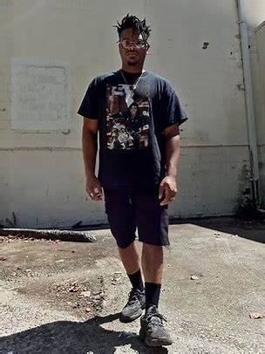
VFD Tech Men… don’t

Slide 8
Violations & Disciplinary Consequences
It is the responsibility of reporting managers/supervisors/HR department to inform the employees that they have violated the dress code policy. In case of violation the employee can immediately correct the problem. Supervisor may allow the employee to leave the work and go out to change the clothes.
A repeated violation of dress code may lead to major repercussions and result into a disciplinary action which includes termination. The termination of an employee can occur in case of dress code violation if:
Repeated dress code violations even after receive the warning and memo from HR department.
In case the inappropriate appearance of employee leads to irreparable damage such as loss of important client or deal.

Slide 9
CONTACT
Thank You
Email
Phone Number
Plot 10B Admiralty Way, Lekki Phase 1, Lagos
19

